Slide 1
Deep Learning in Information Retrieval
Vagelis Hristidis
Prepared with the help of Nhat Le, Shihab Rashid
Some slides are from Richard Socher, Stanford CS224d: Deep Learning for NLP

Slide 2
First Generation: word2vec and friends (2013-2017)

Slide 3
To compare pieces of text
We need effective representation of :
Words
Sentences
Text
Approach 1: Use existing thesauri or ontologies like WordNet and Snomed CT (for medical). Drawbacks:
Manual
Not context specific
Approach 2: Use co-occurrences for word similarity. Drawbacks:
Quadratic space needed
Relative position and order of words not considered

Slide 4
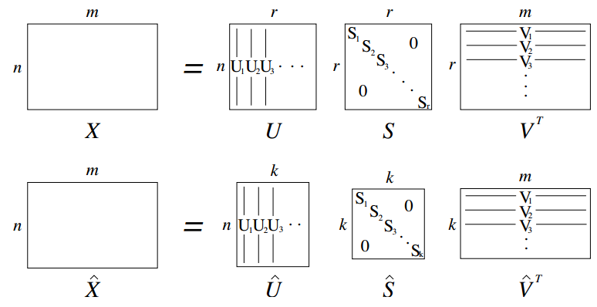
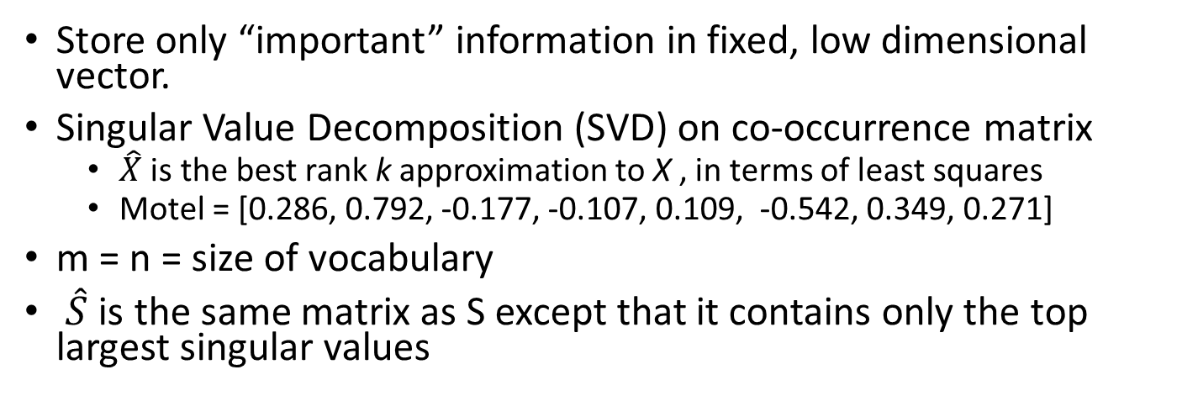
Approach 3: low dimensional vectors
Store only “important” information in fixed, low dimensional vector.
Singular Value Decomposition (SVD) on co-occurrence matrix
$\hat{X}$ is the best rank k approximation to X , in terms of least squares
Motel = [0.286, 0.792, -0.177, -0.107, 0.109, -0.542, 0.349, 0.271]
m = n = size of vocabulary
$\hat{S}$ is the same matrix as S except that it contains only the top largest singular values

Slide 5
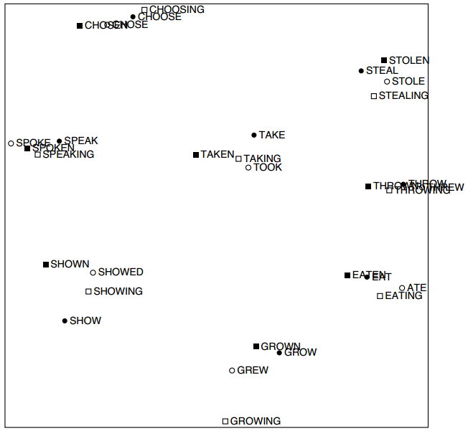
Approach 3: low dimensional vectors
An Improved Model of Semantic Similarity Based on Lexical Co-Occurrence, Rohde et al. 2005

Slide 6
Problems with SVD
Computational cost scales quadratically for n x m matrix: O(mn²) flops (when n<m)
Hard to incorporate new words or documents
Does not consider order of words

Slide 7
word2vec approach to represent the meaning of word
Represent each word with a low-dimensional vector
Word similarity = vector similarity
Key idea: Predict surrounding words of every word
Faster and can easily incorporate a new sentence/document or add a word to the vocabulary

Slide 8
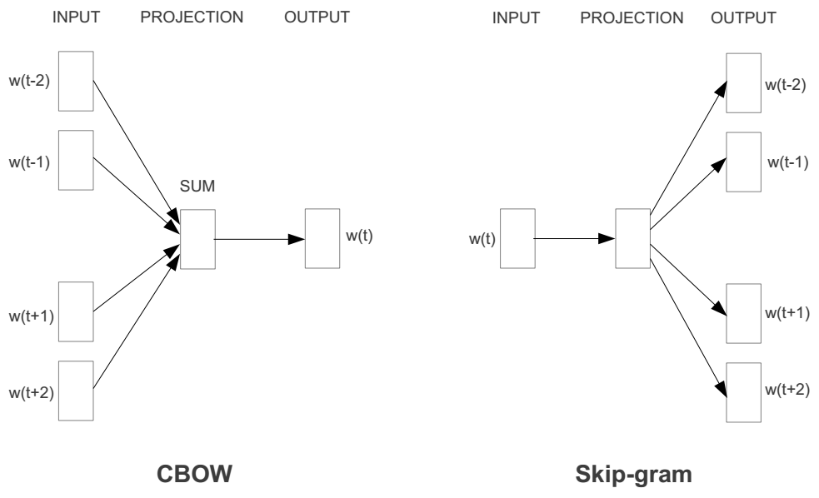
Represent the meaning of word – word2vec
2 basic neural network models:
Continuous Bag of Word (CBOW): use a window of word to predict the middle word
Skip-gram (SG): use a word to predict the surrounding ones in window.

Slide 9
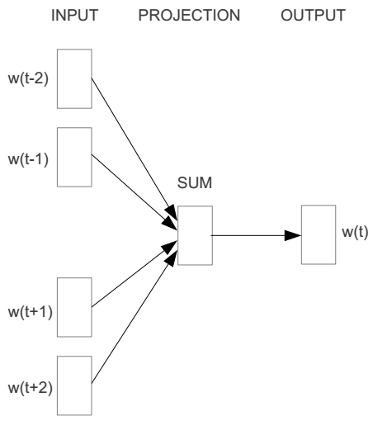
Word2vec – Continuous Bag of Word
E.g. “The cat sat on floor”
Window size = 2
the
cat
sat
on
floor

Slide 10
Input layer
Index of cat in vocabulary
0
1
0
cat
0
Hidden layer
Output layer
0
0
0
0
0
0
…
0
0
0
one-hot
vector
0
sat
one-hot
vector
0
0
0
0
1
0
…
1
0
on
0
0
0
0
…
0

Slide 11



We must learn W and W’
Input layer
0
1
0
cat
0
$$W_{V×N}$$
Hidden layer
Output layer
0
0
0
0
0
0
V-dim
…
0
0
$${W′}_{N×V}$$
0
0
sat
0
0
0
0
1
0
$$W_{V×N}$$
N-dim
…
V-dim
1
0
on
0
0
0
0
V-dim
…
N will be the size of word vector
0

Slide 12
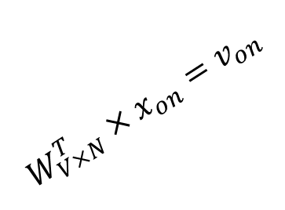

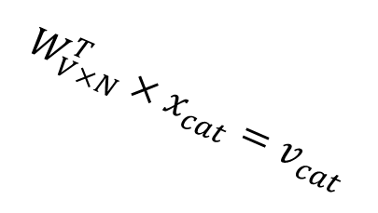



$$W_{V×N}^{T} ×x_{cat}=v_{cat}$$
0.1 | 2.4 | 1.6 | 1.8 | 0.5 | 0.9 | … | … | … | 3.2
0.5 | 2.6 | 1.4 | 2.9 | 1.5 | 3.6 | … | … | … | 6.1
… | … | … | … | … | … | … | … | … | …
… | … | … | … | … | … | … | … | … | …
0.6 | 1.8 | 2.7 | 1.9 | 2.4 | 2.0 | … | … | … | 1.2
0
2.4
2.6
…
…
1.8
Input layer
1
$$×$$
0
$$=$$
0
0
1
0
0
0
x_{cat}
0
0
Output layer
0
0
0
$$W_{V×N}^{T}×x_{cat}=v_{cat}$$
…
0
0
0
0
0
V-dim
…
0
0
$$\hat{v}=\frac{v_{cat}+v_{on}}{2}$$
0
+
0
sat
0
0
0
0
$$W_{V×N}^{T}×x_{on}=v_{on}$$
1
0
…
V-dim
1
Hidden layer
0
x_{on}
0
0
N-dim
0
0
V-dim
…
0

Slide 13

$$W_{V×N}^{T} ×x_{on}=v_{on}$$
0.1 | 2.4 | 1.6 | 1.8 | 0.5 | 0.9 | … | … | … | 3.2
0.5 | 2.6 | 1.4 | 2.9 | 1.5 | 3.6 | … | … | … | 6.1
… | … | … | … | … | … | … | … | … | …
… | … | … | … | … | … | … | … | … | …
0.6 | 1.8 | 2.7 | 1.9 | 2.4 | 2.0 | … | … | … | 1.2
0
1.8
2.9
…
…
1.9
Input layer
0
$$×$$
0
$$=$$
0
1
1
0
0
0
x_{cat}
0
0
Output layer
0
0
0
$$W_{V×N}^{T}×x_{cat}=v_{cat}$$
…
0
0
0
0
0
V-dim
…
0
0
$$\hat{v}=\frac{v_{cat}+v_{on}}{2}$$
0
+
0
sat
0
0
0
0
$$W_{V×N}^{T}×x_{on}=v_{on}$$
1
0
…
V-dim
1
Hidden layer
0
x_{on}
0
0
N-dim
0
0
V-dim
…
0

Slide 14






Input layer
0
1
0
cat
0
$$W_{V×N}$$
Hidden layer
Output layer
0
0
0
0
0
0
V-dim
…
0
0
$$W_{V×N}^{′}×\hat{v}=z$$
0
$$\hat{y}=softmax(z)$$
0
0
0
0
0
$$\hat{v}$$
1
0
$$W_{V×N}$$
…
1
N-dim
0
on
0
${\hat{y}}_{sat}$
0
0
V-dim
0
V-dim
…
N will be the size of word vector
0

Slide 15


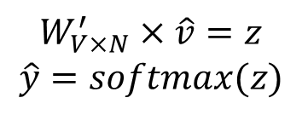
Input layer
0
We would prefer $\hat{y}$ close to ${\hat{y}}_{sat}$
1
0
cat
0
$$W_{V×N}$$
Hidden layer
Output layer
0
0
0
0
0.01
0.02
0.00
0.02
0.01
0.02
0.01
0.7
…
0.00
0
0
V-dim
…
0
0
$$W_{V×N}^{′}×\hat{v}=z$$
$$\hat{y}=softmax(z)$$
0
0
0
0
0
0
$$\hat{v}$$
1
0
$$W_{V×N}$$
…
1
N-dim
0
on
0
${\hat{y}}_{sat}$
0
0
V-dim
0
V-dim
…
N will be the size of word vector
$\hat{y}$
0

Slide 16




$$W_{V×N}^{T}$$
0.1 | 2.4 | 1.6 | 1.8 | 0.5 | 0.9 | … | … | … | 3.2
0.5 | 2.6 | 1.4 | 2.9 | 1.5 | 3.6 | … | … | … | 6.1
… | … | … | … | … | … | … | … | … | …
… | … | … | … | … | … | … | … | … | …
0.6 | 1.8 | 2.7 | 1.9 | 2.4 | 2.0 | … | … | … | 1.2
Contain word’s vectors
Input layer
0
1
0
x_{cat}
0
Output layer
0
0
$$W_{V×N}^{}$$
0
0
0
0
V-dim
…
0
0
$$W_{V×N}^{′}$$
0
0
sat
0
0
0
0
1
0
$$W_{V×N}^{}$$
…
1
0
V-dim
x_{on}
0
Hidden layer
0
N-dim
0
0
V-dim
…
0
We can consider either W or W’ as the word’s representation. Or even take the average.
Notes:
W contains input word vectors.
W’ contains output word vectors.
We can consider either W or W’ as the word’s representation. Or even take the average.

Slide 17
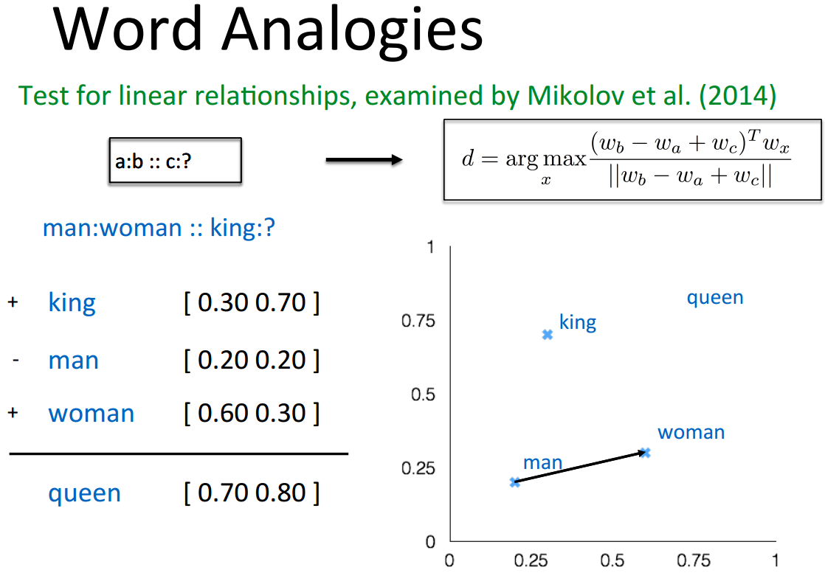
Some interesting results

Slide 18
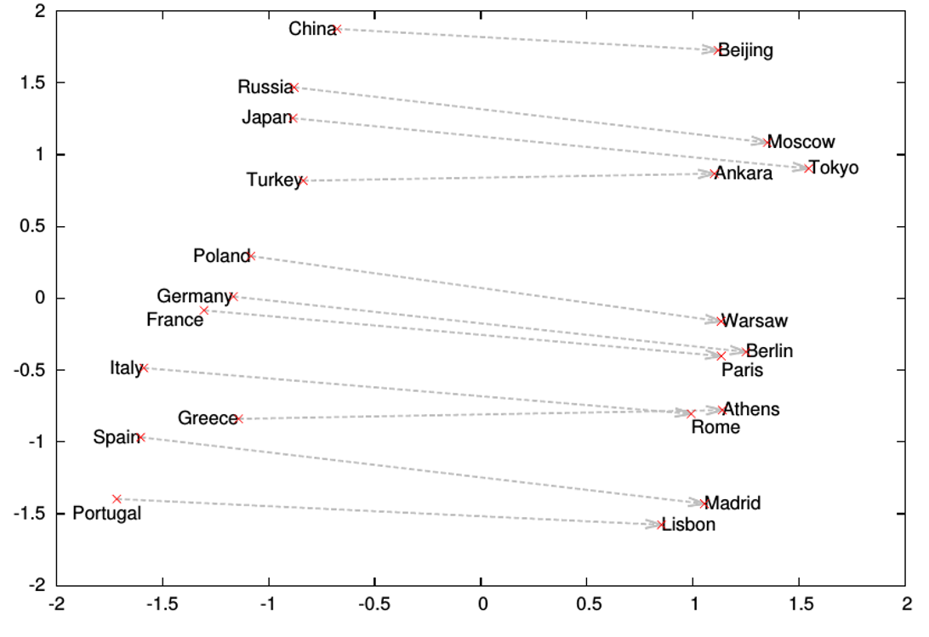
Word analogies

Slide 19
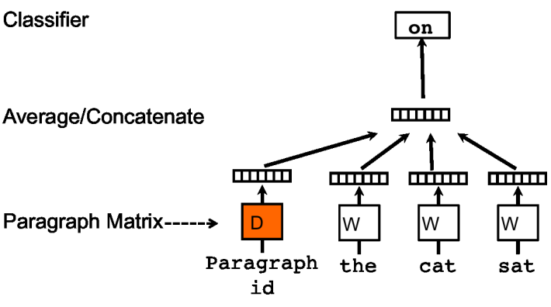
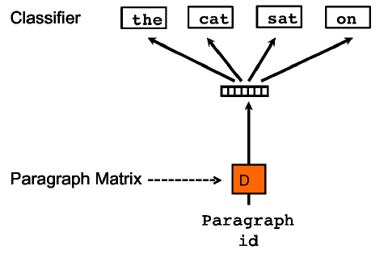
Represent the meaning of sentence/text
Simple approach: take avg of the word2vecs of its words
Another approach: Paragraph vector (2014, Quoc Le, Mikolov)
Extend word2vec to text level
Also two models: add paragraph vector as the input

Slide 20
Applications
Search, e.g., query expansion
Sentiment analysis
Classification
Clustering

Slide 21
Resources
Stanford CS224d: Deep Learning for NLP
http://cs224d.stanford.edu/index.html
The best
“word2vec Parameter Learning Explained”, Xin Rong
https://ronxin.github.io/wevi/
Word2Vec Tutorial - The Skip-Gram Model
http://mccormickml.com/2016/04/19/word2vec-tutorial-the-skip-gram-model/
Improvements and pre-trained models for word2vec:
https://nlp.stanford.edu/projects/glove/
https://fasttext.cc/ (by Facebook)

Slide 22
Second Generation: Transformers (2017+)

Slide 23
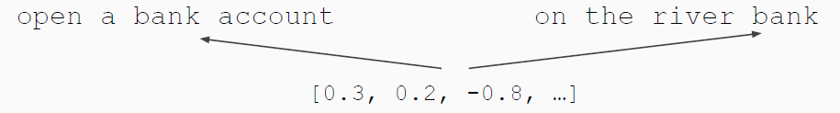
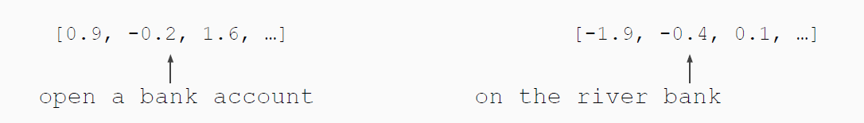
Context-aware embeddings
Word embeddings are the basis of deep learning for NLP
Word embeddings (word2vec, GloVe) are often pre-trained on text corpus from co-occurrence statistics
Problem: Word embeddings are applied in a context free manner
Solution: Train contextual representations on text corpus
Source: Yangqiu Song, ust.hk

Slide 24
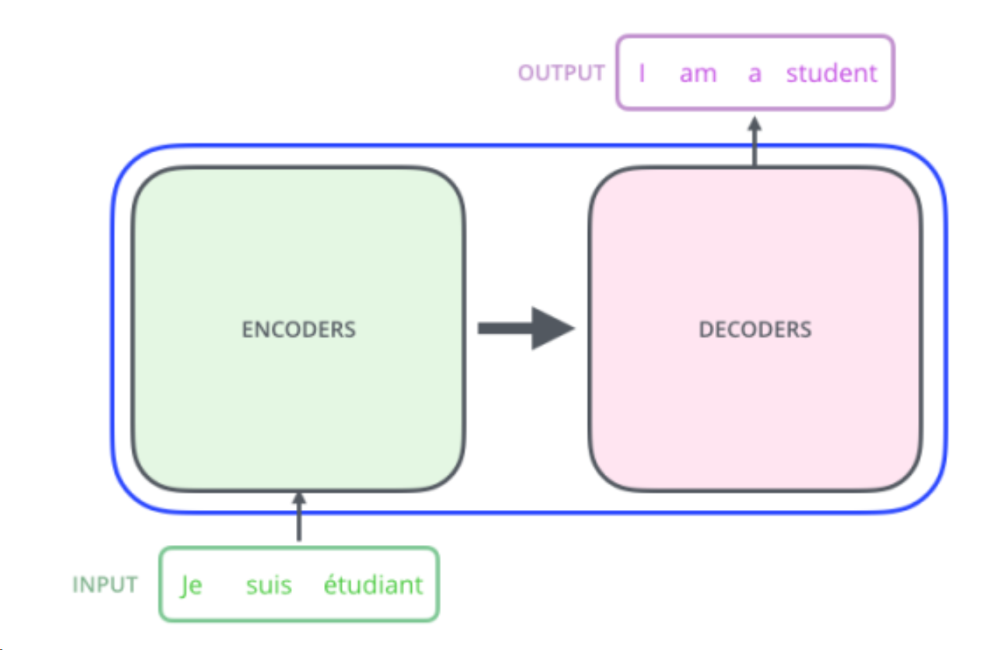
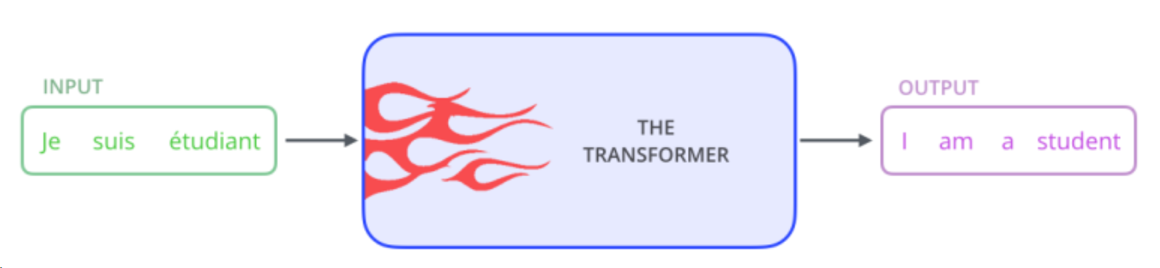
Background: Transformer
Vaswani, Ashish, Noam Shazeer, Niki Parmar, Jakob Uszkoreit, Llion Jones, Aidan N. Gomez, Łukasz Kaiser, and Illia Polosukhin. "Attention is all you need." Advances in neural information processing systems 30 (2017).
https://jalammar.github.io/illustrated-transformer/

Slide 25
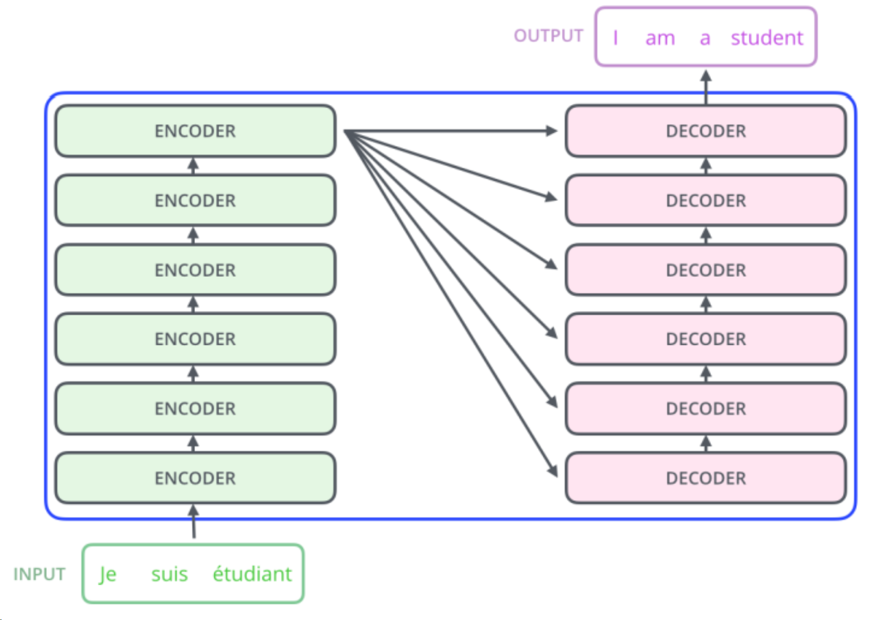
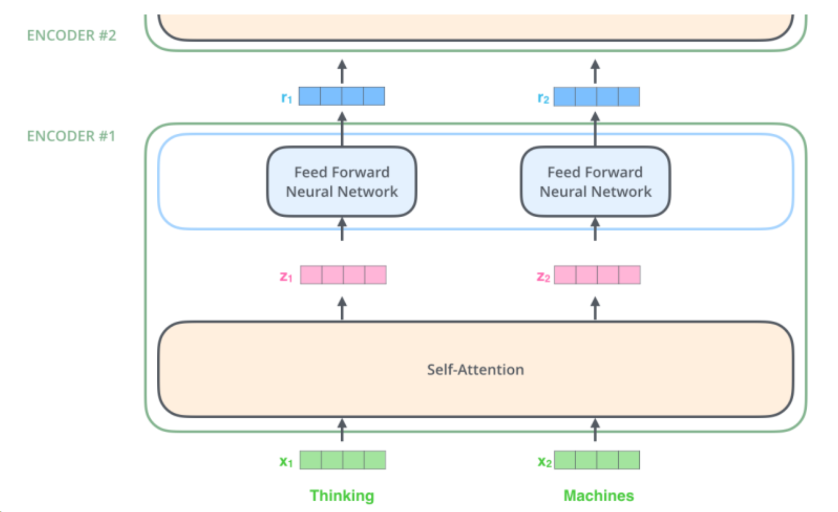
Background: Transformer (cont’d)

Slide 26
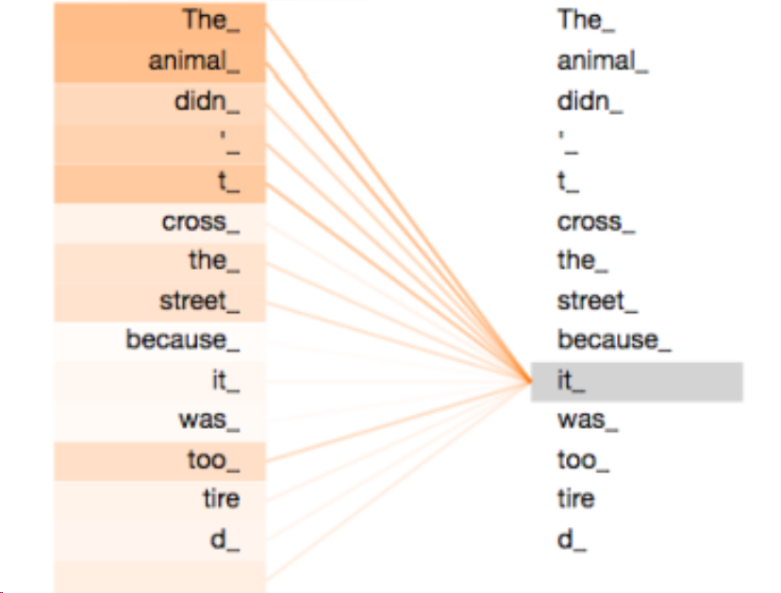
Background: Transformer Self-Attention

Slide 27
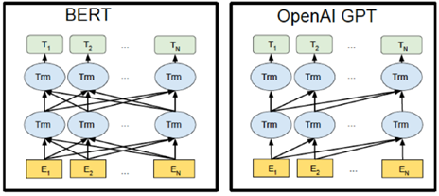
BERT vs. GPT
BERT utilizes the encoder part of the Transformer model, whereas GPT the decoder part.

Slide 28
BERT: Bidirectional Encoder Representation from Transformers
How does BERT work
General purpose language training using enormous pile of unannotated text (pre-training)
Fine-tune for various tasks
Transformers has encoders to read text input and decoders to produce a prediction. Since BERT's goal is to generate language representation model, it only needs encoder.
Model Input: A sequence of tokens
Model Output: A sequence of vectors (a vector of size 768 for each token for BERT-BASE)

Slide 29
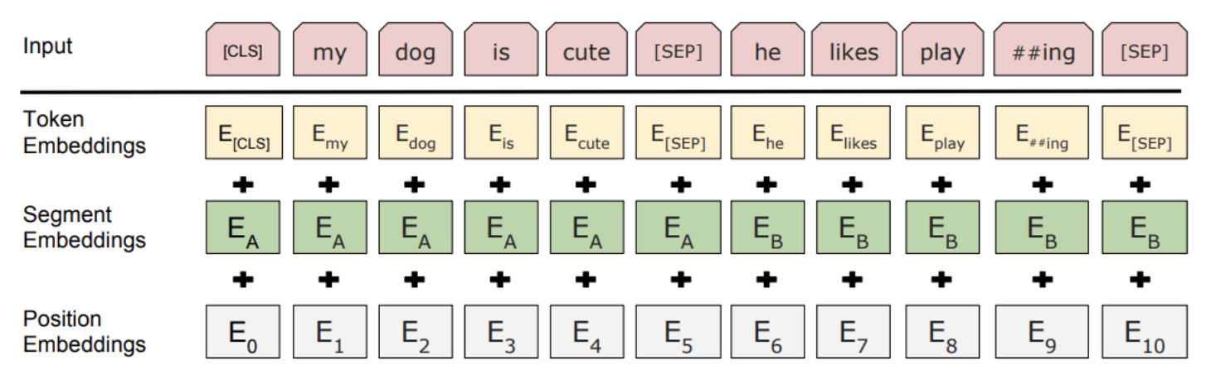
Pre-Training
Previous language models were either context-free (word2vec) or context-based (left-to-right: OpenAI, bi-directional: ELMo)
BERT looks at sequence of tokens all at once (so technically it is non-directional)
Pre-training is done using two steps: Masked LM and Next Sentence Prediction (NSP)
Input representation:
“Devlin, J., Chang, M. W., Lee, K., & Toutanova, K. (2018). Bert: Pre-training of deep bidirectional transformers for language understanding. arXiv preprint arXiv:1810.04805.”

Slide 30
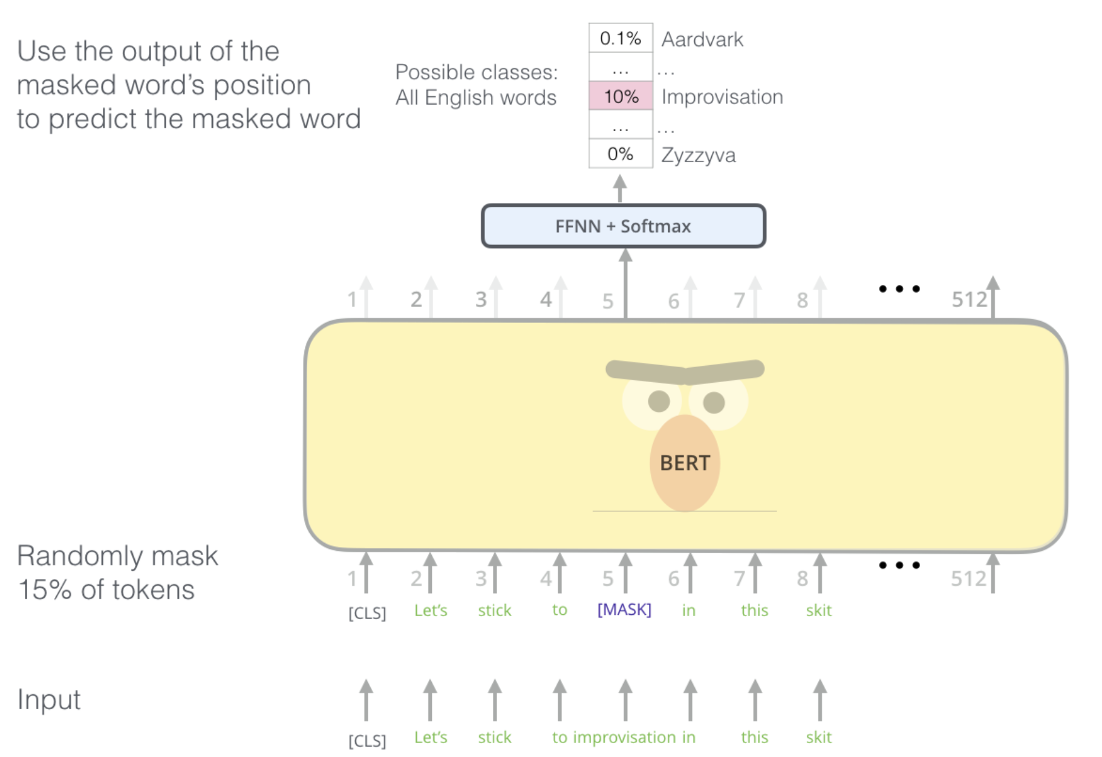
Pre-Training: Masked LM
Randomly mask out 15% of the words in the input — replacing them with a [MASK] token
Run entire sequence through the BERT attention based encoder and then predict only the masked words
http://jalammar.github.io/illustrated-bert/

Slide 31
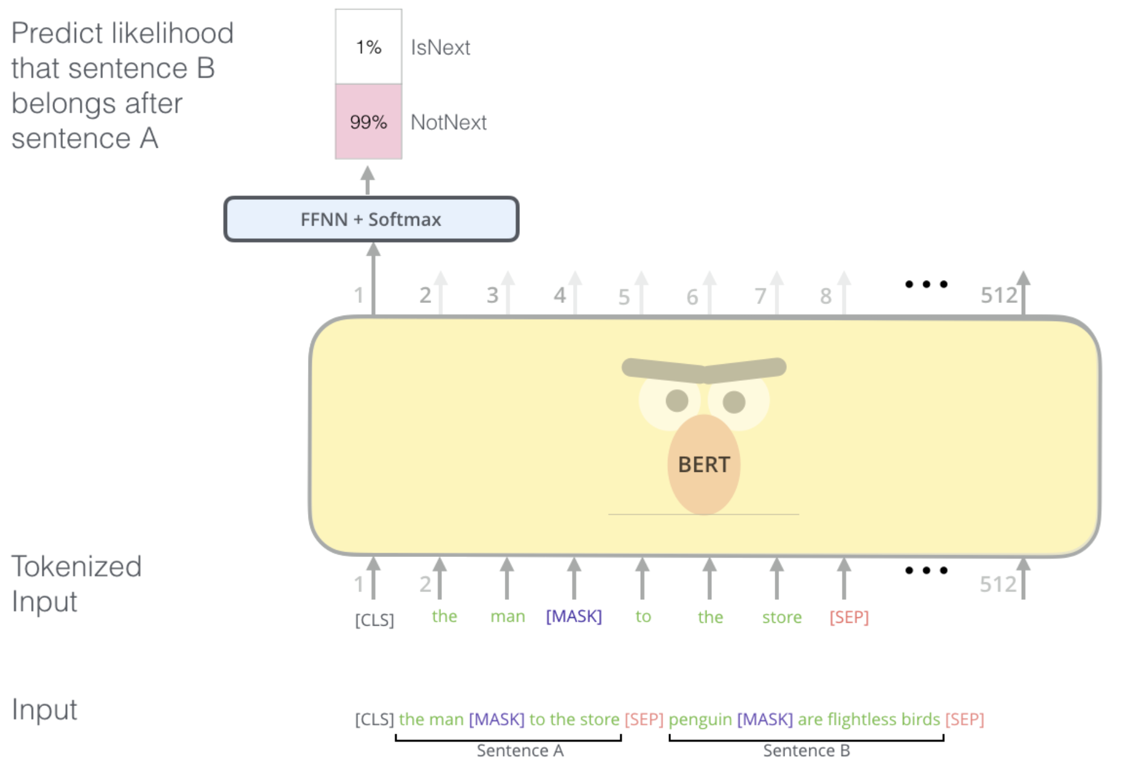
Pre-Training: Next Sentence Prediction (more recent studies show that it may not help much)
Understand relationship between two sentences
Given two sentences (A and B), is B likely to be the sentence that follows A, or not?
Input: The whole tokenized sequence
Output: Softmaxed 2x1 vector of [CLS] token (IsNext or NotNext)
http://jalammar.github.io/illustrated-bert/

Slide 32
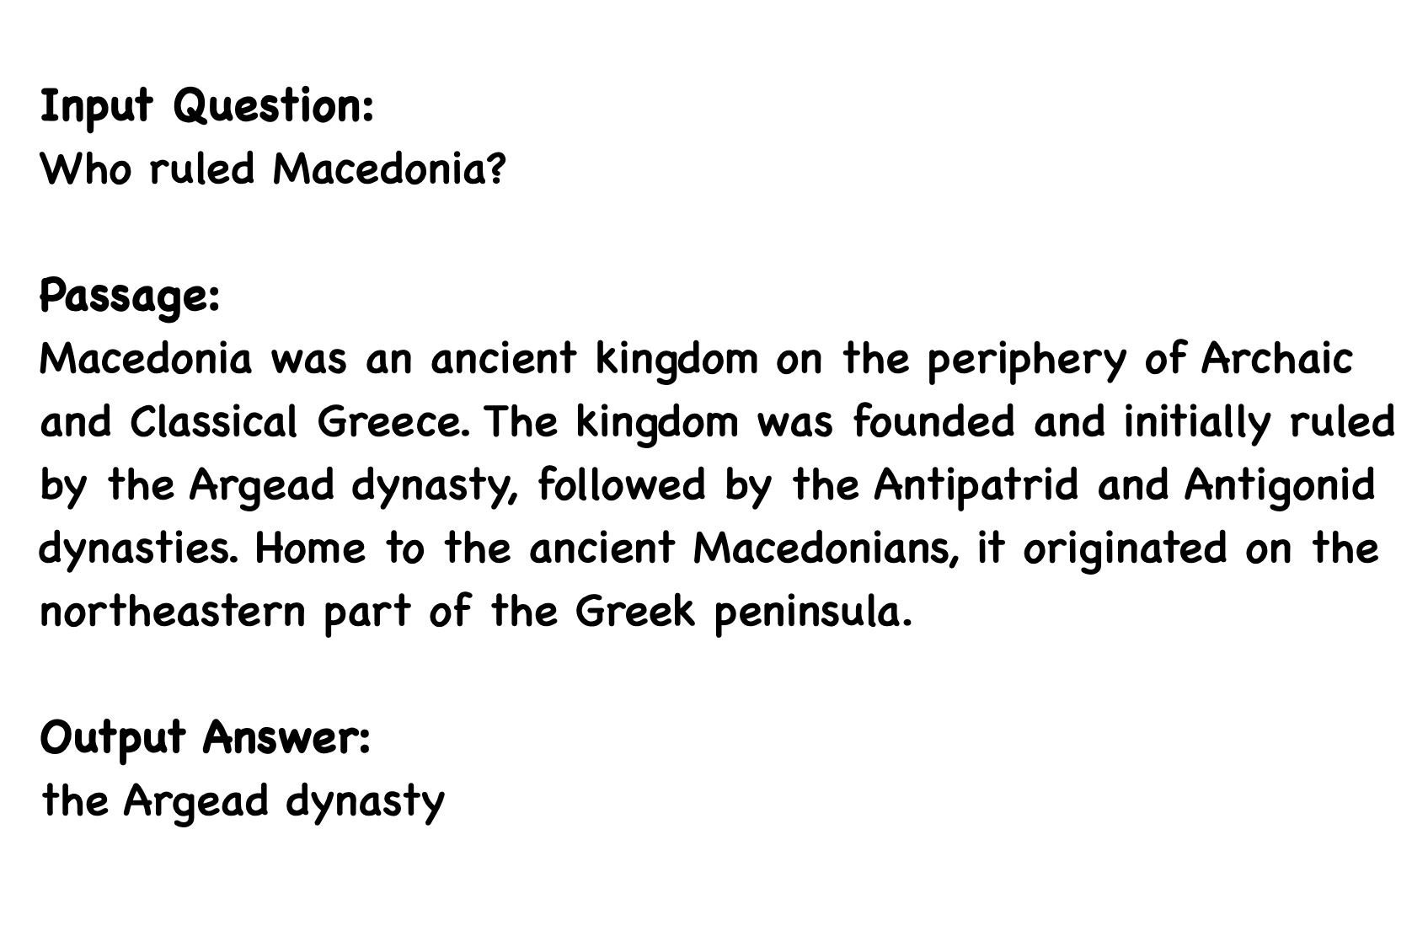
Fine-tuning BERT for Question Answering
Input: question and passage as a single packed sequence
Output: the span of answer within the given passage
Input embeddings are sum of token embeddings and segment embeddings
A [CLS] token added to beginning of question and [SEP] token inserted at the end of both question and paragraph

Slide 33
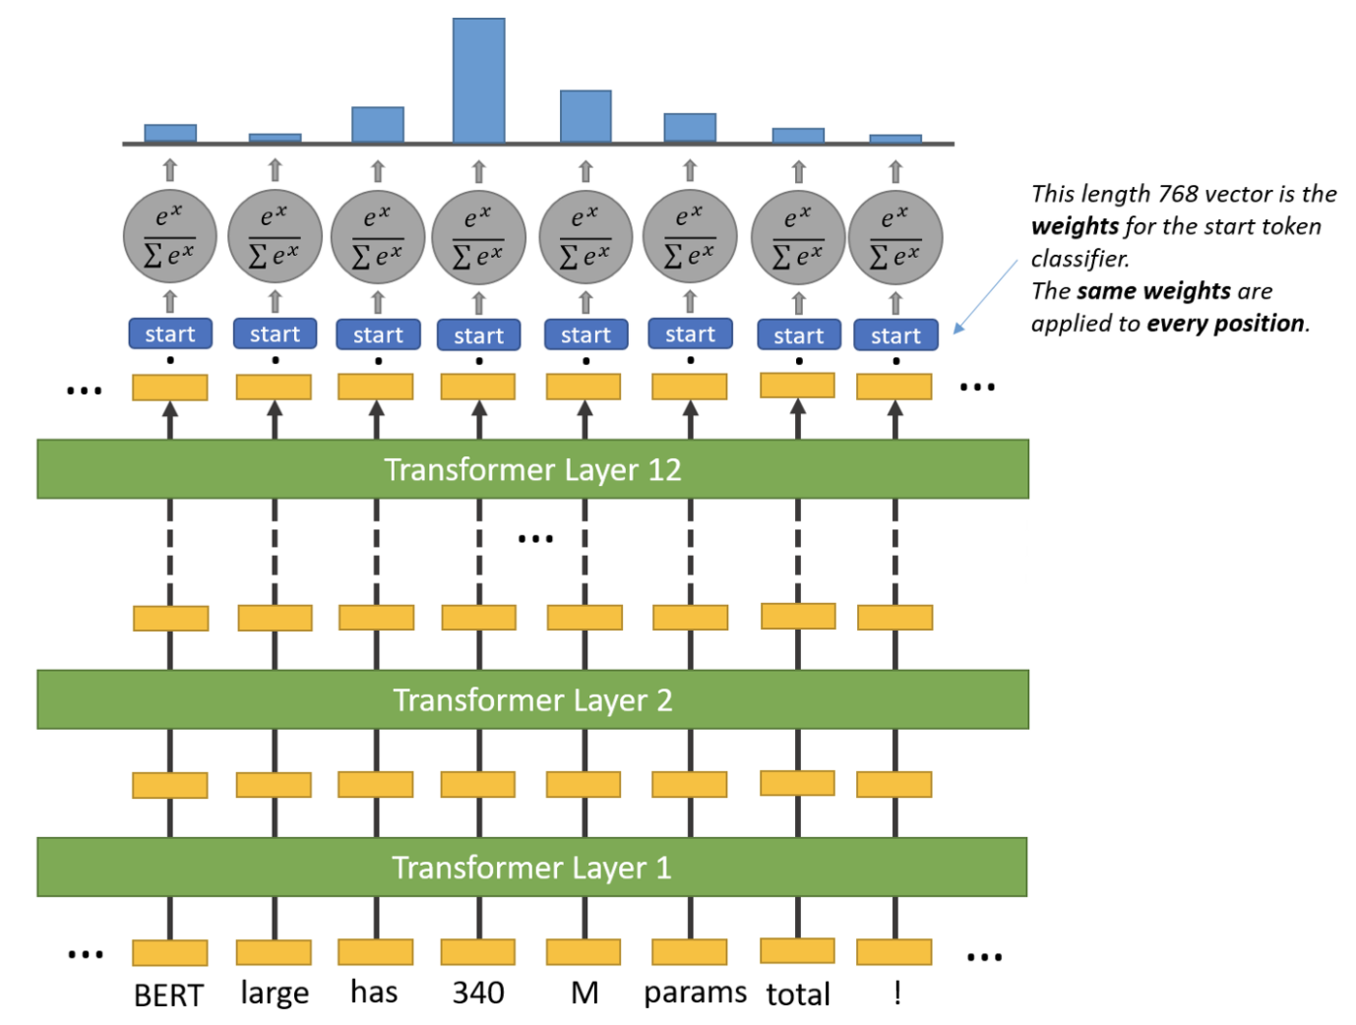
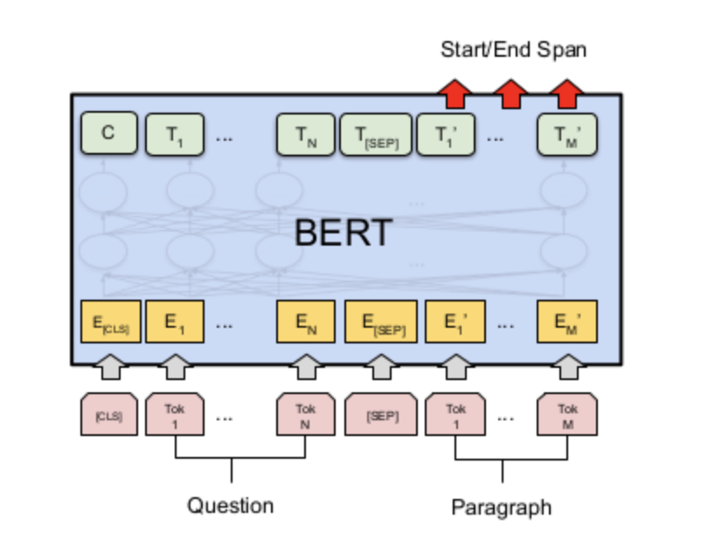
BERT For Question Answering
“Devlin, J., Chang, M. W., Lee, K., & Toutanova, K. (2018). Bert: Pre-training of deep bidirectional transformers for language understanding. arXiv preprint arXiv:1810.04805.”
https://medium.com/saarthi-ai/build-a-smart-question-answering-system-with-fine-tuned-bert-b586e4cfa5f5#:~:text=BERT%20uses%20Transformer%20encoder%20blocks,MLM)%20pre%2Dtraining%20objective.

Slide 34
BERT For Question Answering
A start vector and end vector is introduced
The state of last hidden layer is taken and fed into the start token classifier. The start token classifier only has a single set of weights which it applies to every word.
The word with the highest probability value is considered.
This process is repeated for end token classifier
The model returns two indexes: [start_token_index, end_token_index]
The corresponding span from start index to end index is the answer
Notes:
Query and passage are processed (embeddings) and passed as inputs
The probability of each word being the start-word is calculated by taking a dot product between the final embedding of the word and the start vector, followed by a softmax over all the words.

Slide 35
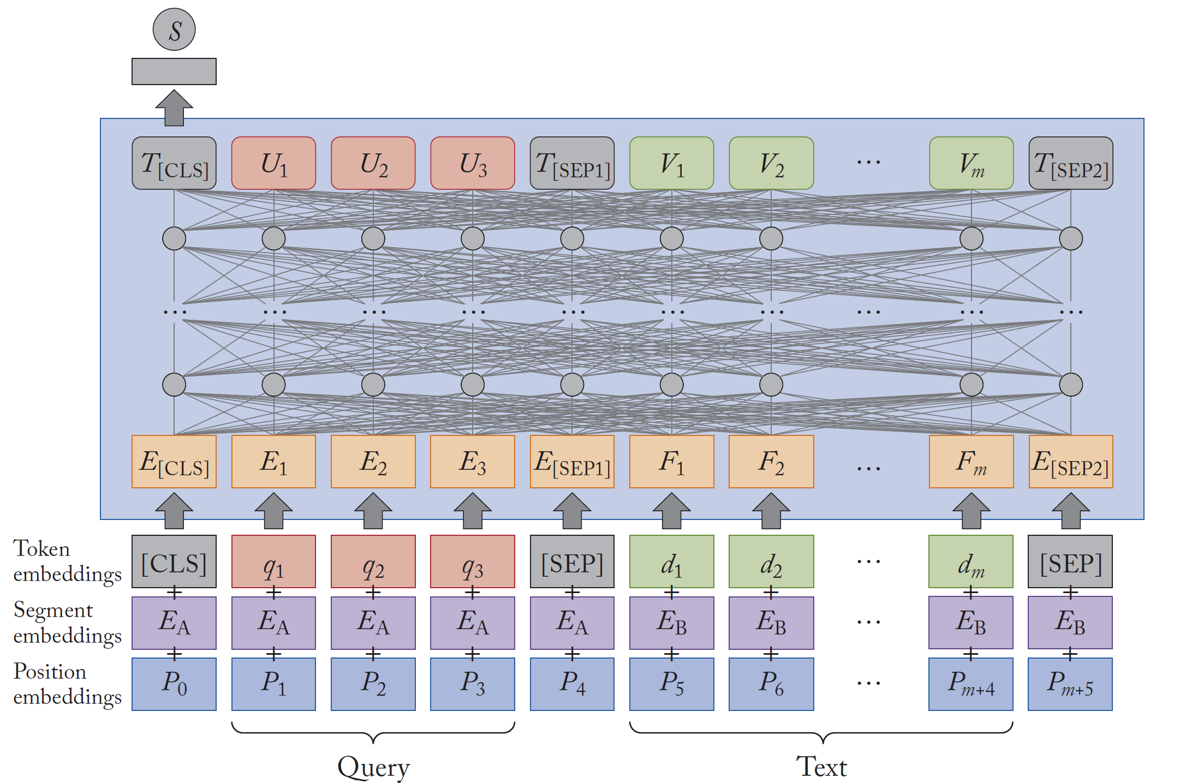
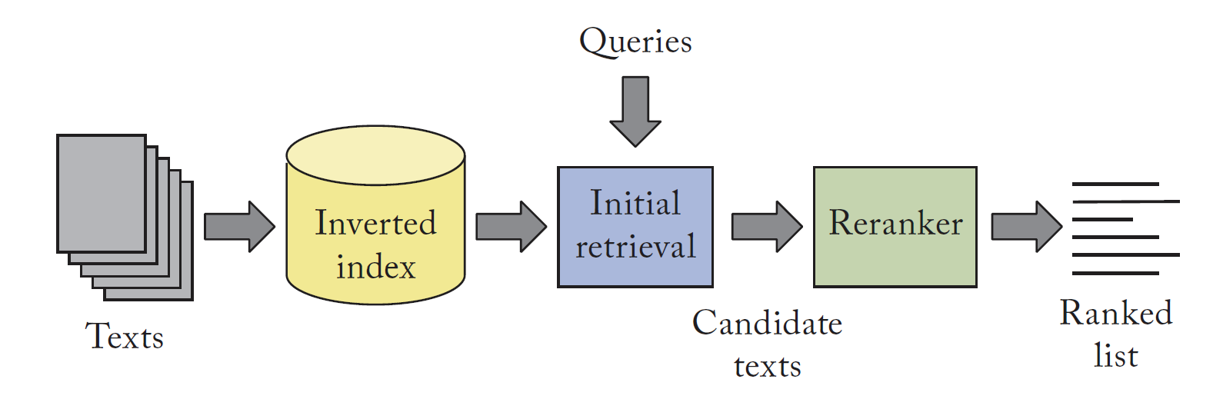
BERT for ranking
Used as Reranker
Classic methods like BM25 used for initial retrieval
The final representation of the [CLS] token is fed to a fully
connected layer that produces the relevance score S of the text with respect to the query.
Lin, Jimmy, Rodrigo Nogueira, and Andrew Yates. "Pretrained transformers for text ranking: Bert and beyond." Synthesis Lectures on Human Language Technologies 14, no. 4 (2021): 1-325.

Slide 36
BERT for Open Retrieval Question Answering
K documents
K reranked documents
Retriever
(BM25)
Reranker
(BERT)
Reader
(Positional BERT)
Answer
Question
Qu, Chen, Liu Yang, Cen Chen, Minghui Qiu, W. Bruce Croft, and Mohit Iyyer. "Open-retrieval conversational question answering." In Proceedings of the 43rd International ACM SIGIR conference on research and development in Information Retrieval, pp. 539-548. 2020.

Slide 37
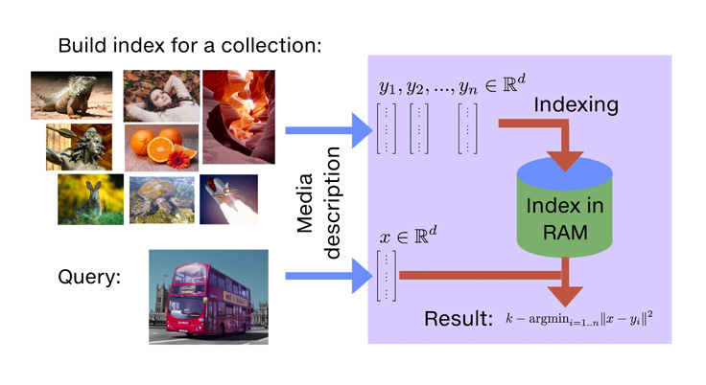
Indexing for embeddings
Given n embeddings in a collection and a query embedding q, find k most similar items
Brute force
Approximation
Compress dimension of embeddings
Product quantization
Faiss is popular library
Leverages large memory, GPUs, multithreading
https://github.com/facebookresearch/faiss/

Slide 38
End

Slide 39
Transformer Overview
Sequence-to-sequence
Encoder-Decoder
Task: machine translation with parallel corpus
Predict each translated word
Use attention -> can be parallelized as there is not dependence to previous iteration (as is the case for Recurrent Neural Networks)
https://arxiv.org/pdf/1706.03762.pdf

